Slide 1
Image classification
tooYoungTooSimple
Department of Statistics
The University of Georgia

Slide 2
Overview
Introduction
Data Preprocessing
Tool Configuration
Modeling
Prediction

Slide 3

Introduction
CIFAR-10 image dataset, 10 different labeled categories
32 $×$ 32 pixels, 3 color channels: standard RGB format

Slide 4

Data Preprocessing
Convert the PNGs to 3072 (32 $×$ 32 $×$ 3) color levels (weight/feature)
Convert the pixel data to the RNN input format
Transform the data by normalization, centralizing, cropping, etc.

Slide 5
Tool Configuration
CUDA 7.5, cuDNN v5
Torch on Ubuntu 14.04 Amazon EC2 GPU Instances with CUDA GPU
Notes:
Install Torch on Ubuntu 14.04 Amazon EC2 GPU Instances with CUDA GPU

Slide 6
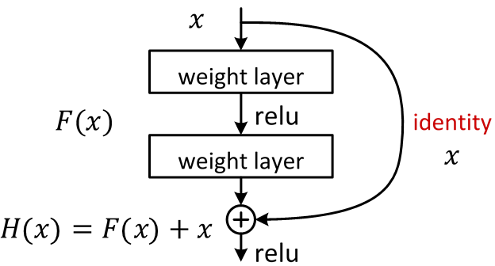
modeling
Residual Neural Network (RNN)
Referred paper: Deep Residual Learning for Image Recognition, Kaiming He, Xiangyu Zhang, Shaoqing Ren, Jian Sun (2015)
With 119 layers to train, the depth of network is (9n+2), limited by memory
Notes:
About the paper:
This approach is to solve degradation problem, which is when the network depth increases, accuracy gets saturated. It is because additional layers may cause the training error becomes larger.
Solution by construction to the deeper model: the added layers are identity mapping, and the other layers are copied from the learned shallower model.
Deep Residual Learning framework: Instead of fitting a desired underlying mapping directly from each few stacked layers, we explicitly let these layers fit a residual mapping. Denote the desired underlying mapping as H(x), let the stacked nonlinear layers fit another mapping of F(x):= H(x) – x. Then the original mapping becomes F(x) + x. Hypothesize that it is easier to optimize the residual mapping than to optimize the original.
The formulation of F(x) + x can be realized by “shortcut connections”, which is shown to the right. In our case, the shortcut connections simply perform identity mapping, and their outputs are added to the outputs of the stacked layers.

Slide 7
prediction
Add output part to output targets (filenames) and results (labels 1-10)
Reorder the results to match filenames in the test set and predicted categories
Notes:
Modify the “Trainer:test()” function in train.lua
Reorder the result by “X_test.txt”, target and result by changeResultOrder.py

Slide 8
Q & a

